Slide 1

Chapter 6 The Link Layer
and LANs
A note on the use of these PowerPoint slides:
We’re making these slides freely available to all (faculty, students, readers). They’re in PowerPoint form so you see the animations; and can add, modify, and delete slides (including this one) and slide content to suit your needs. They obviously represent a lot of work on our part. In return for use, we only ask the following:
If you use these slides (e.g., in a class) that you mention their source (after all, we’d like people to use our book!)
If you post any slides on a www site, that you note that they are adapted from (or perhaps identical to) our slides, and note our copyright of this material.
For a revision history, see the slide note for this page.
Thanks and enjoy! JFK/KWR
All material copyright 1996-2020
J.F Kurose and K.W. Ross, All Rights Reserved
Computer Networking: A Top-Down Approach 8th edition Jim Kurose, Keith Ross Pearson, 2020
Notes:
Version History
8.0 (May 2020)
All slides reformatted for 16:9 aspect ratio
All slides updated to 8th edition material
Use of Calibri font, rather that Gill Sans MT
Add LOTS more animation throughout
lighter header font
Updated datacenter slides, day-in-the-life

Slide 2

Link layer and LANs: our goals
understand principles behind link layer services:
error detection, correction
sharing a broadcast channel: multiple access
link layer addressing
local area networks: Ethernet, VLANs
datacenter networks
instantiation, implementation of various link layer technologies

Slide 3
Link layer, LANs: roadmap
introduction
error detection, correction
multiple access protocols
LANs
addressing, ARP
Ethernet
switches
VLANs
link virtualization: MPLS
data center networking
a day in the life of a web request

Slide 4








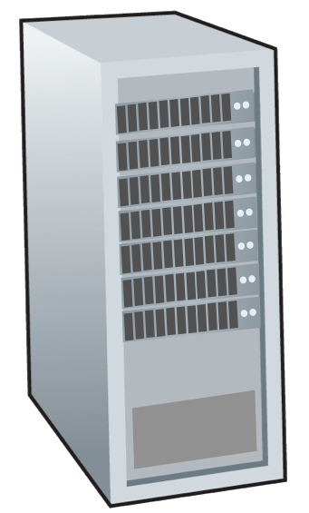







Link layer: introduction
terminology:
hosts and routers: nodes
communication channels that connect adjacent nodes along communication path: links
wired
wireless
LANs
layer-2 packet: frame, encapsulates datagram
mobile network
national or global ISP
datacenter
network
link layer has responsibility of
transferring datagram from one node
to physically adjacent node over a link
enterprise
network

Slide 5
Link layer: context
datagram transferred by different link protocols over different links:
e.g., WiFi on first link, Ethernet on next link
each link protocol provides different services
e.g., may or may not provide reliable data transfer over link
transportation analogy:
trip from Princeton to Lausanne
limo: Princeton to JFK
plane: JFK to Geneva
train: Geneva to Lausanne
tourist = datagram
transport segment = communication link
transportation mode = link-layer protocol
travel agent = routing algorithm

Slide 6


Link layer: services
framing, link access:
encapsulate datagram into frame, adding header, trailer
channel access if shared medium
“MAC” addresses in frame headers identify source, destination (different from IP address!)
reliable delivery between adjacent nodes
we already know how to do this!
seldom used on low bit-error links
wireless links: high error rates
Q: why both link-level and end-end reliability?
…
…

Slide 7
Link layer: services (more)
flow control:
pacing between adjacent sending and receiving nodes
error detection:
errors caused by signal attenuation, noise.
receiver detects errors, signals retransmission, or drops frame
error correction:
receiver identifies and corrects bit error(s) without retransmission
half-duplex and full-duplex:
with half duplex, nodes at both ends of link can transmit, but not at same time
…
…

Slide 8
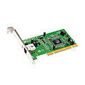
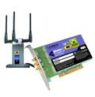

Where is the link layer implemented?
in each-and-every host
link layer implemented in network interface card (NIC) or on a chip
Ethernet, WiFi card or chip
implements link, physical layer
attaches into host’s system buses
combination of hardware, software, firmware
application
transport
network
link
cpu
memory
host bus
(e.g., PCI)
controller
link
physical
physical
network interface

Slide 9
Interfaces communicating
application
transport
network
link
application
transport
network
link
cpu
memory
memory
CPU
datagram
link_{h}
datagram
controller
controller
datagram
link_{h}
link
physical
link
physical
physical
physical
sending side:
encapsulates datagram in frame
adds error checking bits, reliable data transfer, flow control, etc.
receiving side:
looks for errors, reliable data transfer, flow control, etc.
extracts datagram, passes to upper layer at receiving side

Slide 10
Link layer, LANs: roadmap
introduction
error detection, correction
multiple access protocols
LANs
addressing, ARP
Ethernet
switches
VLANs
link virtualization: MPLS
data center networking
a day in the life of a web request

Slide 11
Error detection
EDC: error detection and correction bits (e.g., redundancy)
D: data protected by error checking, may include header fields
datagram
datagram
Error detection not 100% reliable!
protocol may miss some errors, but rarely
larger EDC field yields better detection and correction
otherwise
all
bits in D’
OK
?
N
detected
error
d data bits
D
EDC
D’
EDC’
bit-error prone link

Slide 12
Parity checking
single bit parity:
detect single bit errors
two-dimensional bit parity:
detect and correct single bit errors
row parity
0111000110101011
1
d_{1,1}
. . .
d_{1,j}
d_{1,j+1}
d data bits
d_{2,1}
. . .
d_{2,j}
d_{2,j+1}
parity
bit
. . .
. . .
. . .
. . .
d_{i,1}
. . .
d_{i,j}
d_{i,j+1}
column
parity
d_{i+1,1}
. . .
d_{i+1,j}
d_{i+1,j+1}
Even parity: set parity bit so there is an even number of 1’s
no errors:
1 0 1 0 1 1
detected
and
correctable
single-bit
error:
1 0 1 0 1 1
1 1 1 1 0 0
1 0 1 1 0 0
parity
error
0 1 1 1 0 1
0 1 1 1 0 1
1 0 1 0 1 0
1 0 1 0 1 0
* Check out the online interactive exercises for more examples: http://gaia.cs.umass.edu/kurose_ross/interactive/
parity
error

Slide 13
Internet checksum (review)
Goal: detect errors (i.e., flipped bits) in transmitted segment
sender:
treat contents of UDP segment (including UDP header fields and IP addresses) as sequence of 16-bit integers
checksum: addition (one’s complement sum) of segment content
checksum value put into UDP checksum field
receiver:
compute checksum of received segment
check if computed checksum equals checksum field value:
not equal - error detected
equal - no error detected. But maybe errors nonetheless? More later ….

Slide 14
D represents the data being transmitted, R represents the remainder or CRC checksum, and 2r denotes shifting the bits of R to the left by r positions. The XOR operation is then performed between the shifted remainder (2r) and the original remainder (R).
Cyclic Redundancy Check (CRC): example
A cyclic redundancy check (CRC) is an error-detecting code commonly used in digital networks and storage devices to detect accidental changes to raw data.
more powerful error-detection coding
D: data bits (given, think of these as a binary number)
G: bit pattern (generator), of r+1 bits (given)
r CRC bits
d data bits
D
R
bit pattern
<D,R> = D 2^{r} XOR R
formula for bit pattern
*
goal: choose r CRC bits, R, such that <D,R> exactly divisible by G (mod 2)
receiver knows G, divides <D,R> by G. If non-zero remainder: error detected!
can detect all burst errors less than r+1 bits
widely used in practice (Ethernet, 802.11 WiFi)

Slide 15
Cyclic Redundancy Check (CRC): example
G
We want:
D.2^{r} XOR R = nG
1
0
1
0 1 1
1 0 0 1
1 0 1 1 1 0
0 0 0
or equivalently:
D.2^{r} = nG XOR R
1 0 0 1
1 0 1
D
2^{r}
0 0 0
*
or equivalently:
if we divide D.2^{r} by G, want remainder R to satisfy:
1 0 1 0
1 0 0 1
1 1 0
0 0 0
D.2^{r}
G
1 1 0 0
R = remainder [ ]
1 0 0 1
1 0 1 0
1 0 0 1
0 1 1
R
* Check out the online interactive exercises for more examples: http://gaia.cs.umass.edu/kurose_ross/interactive/

Slide 16
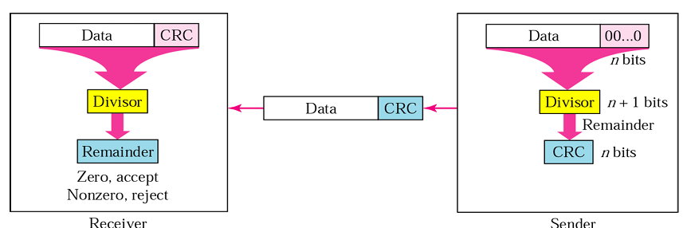
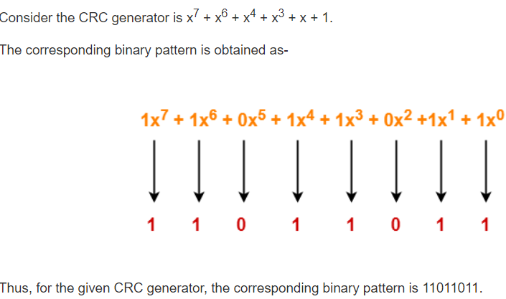
Cyclic Redundancy Check (CRC): example

Slide 17
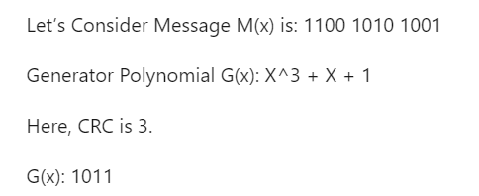
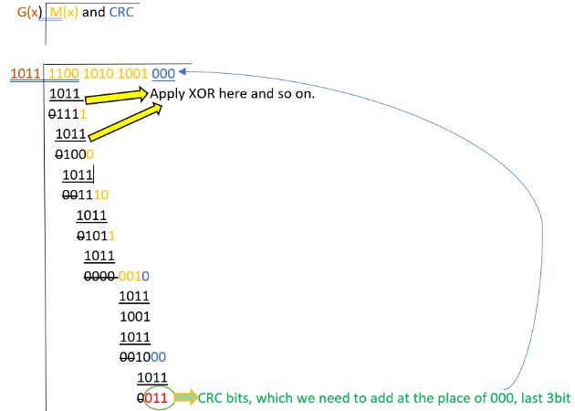
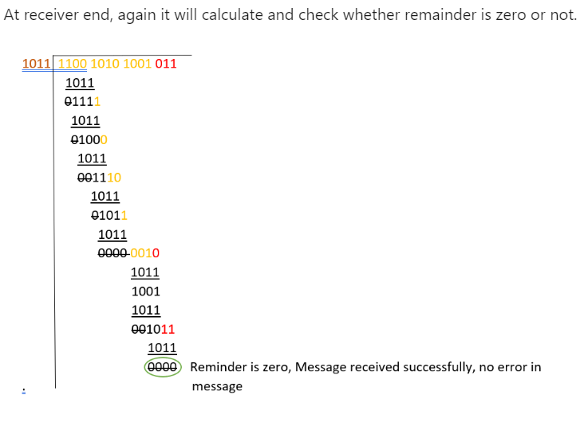
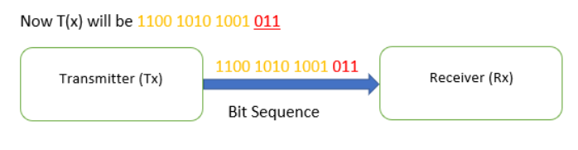
Cyclic Redundancy Check (CRC): example

Slide 18
Cyclic Redundancy Check (CRC): example
Problem-01:
A bit stream 1101011011 is transmitted using the standard CRC method. The generator polynomial is x⁴+x+1. What is the actual bit string transmitted?

Slide 19
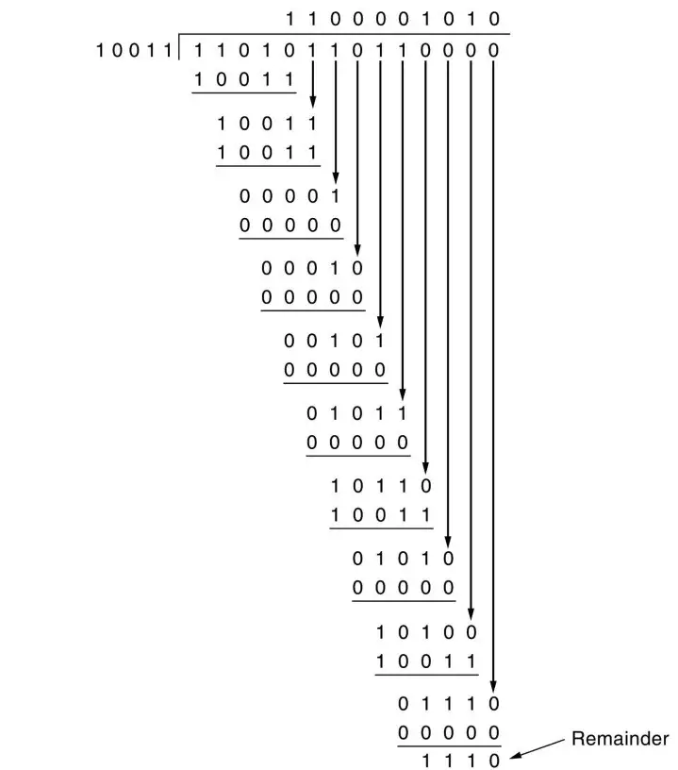
Cyclic Redundancy Check (CRC): example
Problem-01:- Solution
The generator polynomial G(x) = x⁴ + x + 1 is encoded as 10011.
Clearly, the generator polynomial consists of 5 bits.
So, a string of 4 zeroes is appended to the bit stream to be transmitted.
The resulting bit stream is 11010110110000.
From here, CRC = 1110.
Now,
The code word to be transmitted is obtained by replacing the last 4 zeroes of 11010110110000 with the CRC.
Thus, the code word transmitted to the receiver = 11010110111110.

Slide 20
Link layer, LANs: roadmap
introduction
error detection, correction
multiple access protocols
LANs
addressing, ARP
Ethernet
switches
VLANs
link virtualization: MPLS
data center networking
a day in the life of a web request

Slide 21



Multiple access links, protocols
two types of “links”:
point-to-point
point-to-point link between Ethernet switch, host
PPP for dial-up access
broadcast (shared wire or medium)
old-fashioned Ethernet
upstream HFC in cable-based access network
802.11 wireless LAN, 4G/4G. satellite
shared wire (e.g.,
cabled Ethernet)
shared radio: 4G/5G
shared radio: WiFi
shared radio: satellite
humans at a cocktail party
(shared air, acoustical)

Slide 22
Multiple access protocols
single shared broadcast channel
two or more simultaneous transmissions by nodes: interference
collision if node receives two or more signals at the same time
multiple access protocol
distributed algorithm that determines how nodes share channel, i.e., determine when node can transmit
communication about channel sharing must use channel itself!
no out-of-band channel for coordination

Slide 23
An ideal multiple access protocol
given: multiple access channel (MAC) of rate R bps
desiderata:
1. when one node wants to transmit, it can send at rate R.
2. when M nodes want to transmit, each can send at average rate R/M
3. fully decentralized:
no special node to coordinate transmissions
no synchronization of clocks, slots
4. simple

Slide 24
MAC protocols: taxonomy
three broad classes:
channel partitioning
divide channel into smaller “pieces” (time slots, frequency, code)
allocate piece to node for exclusive use
random access
channel not divided, allow collisions
“recover” from collisions
“taking turns”
nodes take turns, but nodes with more to send can take longer turns

Slide 25
Channel partitioning MAC protocols: TDMA
TDMA: time division multiple access
access to channel in “rounds”
each station gets fixed length slot (length = packet transmission time) in each round
unused slots go idle
example: 6-station LAN, 1,3,4 have packets to send, slots 2,5,6 idle
6-slot
frame
6-slot
frame
1
3
4
1
3
4

Slide 26
Channel partitioning MAC protocols: FDMA
FDMA: frequency division multiple access
channel spectrum divided into frequency bands
each station assigned fixed frequency band
unused transmission time in frequency bands go idle
example: 6-station LAN, 1,3,4 have packet to send, frequency bands 2,5,6 idle
time
frequency bands
FDM cable

Slide 27
Random access protocols
when node has packet to send
transmit at full channel data rate R.
no a priori coordination among nodes
two or more transmitting nodes: “collision”
random access MAC protocol specifies:
how to detect collisions
how to recover from collisions (e.g., via delayed retransmissions)
examples of random access MAC protocols:
ALOHA, slotted ALOHA
CSMA, CSMA/CD, CSMA/CA

Slide 28
Slotted ALOHA
assumptions:
all frames same size
time divided into equal size slots (time to transmit 1 frame)
nodes start to transmit only slot beginning
nodes are synchronized
if 2 or more nodes transmit in slot, all nodes detect collision
operation:
when node obtains fresh frame, transmits in next slot
if no collision: node can send new frame in next slot
if collision: node retransmits frame in each subsequent slot with probability p until success
randomization – why?

Slide 29
Slotted ALOHA
node 1
1
1
1
1
C: collision
S: success
E: empty
node 2
2
2
2
node 3
3
3
3
C
E
C
S
E
C
E
S
S
Pros:
single active node can continuously transmit at full rate of channel
highly decentralized: only slots in nodes need to be in sync
simple
Cons:
collisions, wasting slots
idle slots
nodes may be able to detect collision in less than time to transmit packet
clock synchronization

Slide 30
Slotted ALOHA: efficiency
efficiency: long-run fraction of successful slots (many nodes, all with many frames to send)
suppose: N nodes with many frames to send, each transmits in slot with probability p
prob that given node has success in a slot = p(1-p)^{N-1}
prob that any node has a success = Np(1-p)^{N-1}
max efficiency: find p* that maximizes Np(1-p)^{N-1}
for many nodes, take limit of Np*(1-p*)^{N-1} as N goes to infinity, gives:
max efficiency = 1/e = .37
at best: channel used for useful transmissions 37% of time!

Slide 31
Pure ALOHA
unslotted Aloha: simpler, no synchronization
when frame first arrives: transmit immediately
collision probability increases with no synchronization:
frame sent at t₀ collides with other frames sent in [t₀-1,t₀+1]
will overlap
with start of
i’s frame
will overlap
with end of
i’s frame
t₀ - 1
t₀
t₀ + 1
pure Aloha efficiency: 18% !

Slide 32
CSMA (carrier sense multiple access)
simple CSMA: listen before transmit:
if channel sensed idle: transmit entire frame
if channel sensed busy: defer transmission
human analogy: don’t interrupt others!
CSMA/CD: CSMA with collision detection
collisions detected within short time
colliding transmissions aborted, reducing channel wastage
collision detection easy in wired, difficult with wireless
human analogy: the polite conversationalist

Slide 33
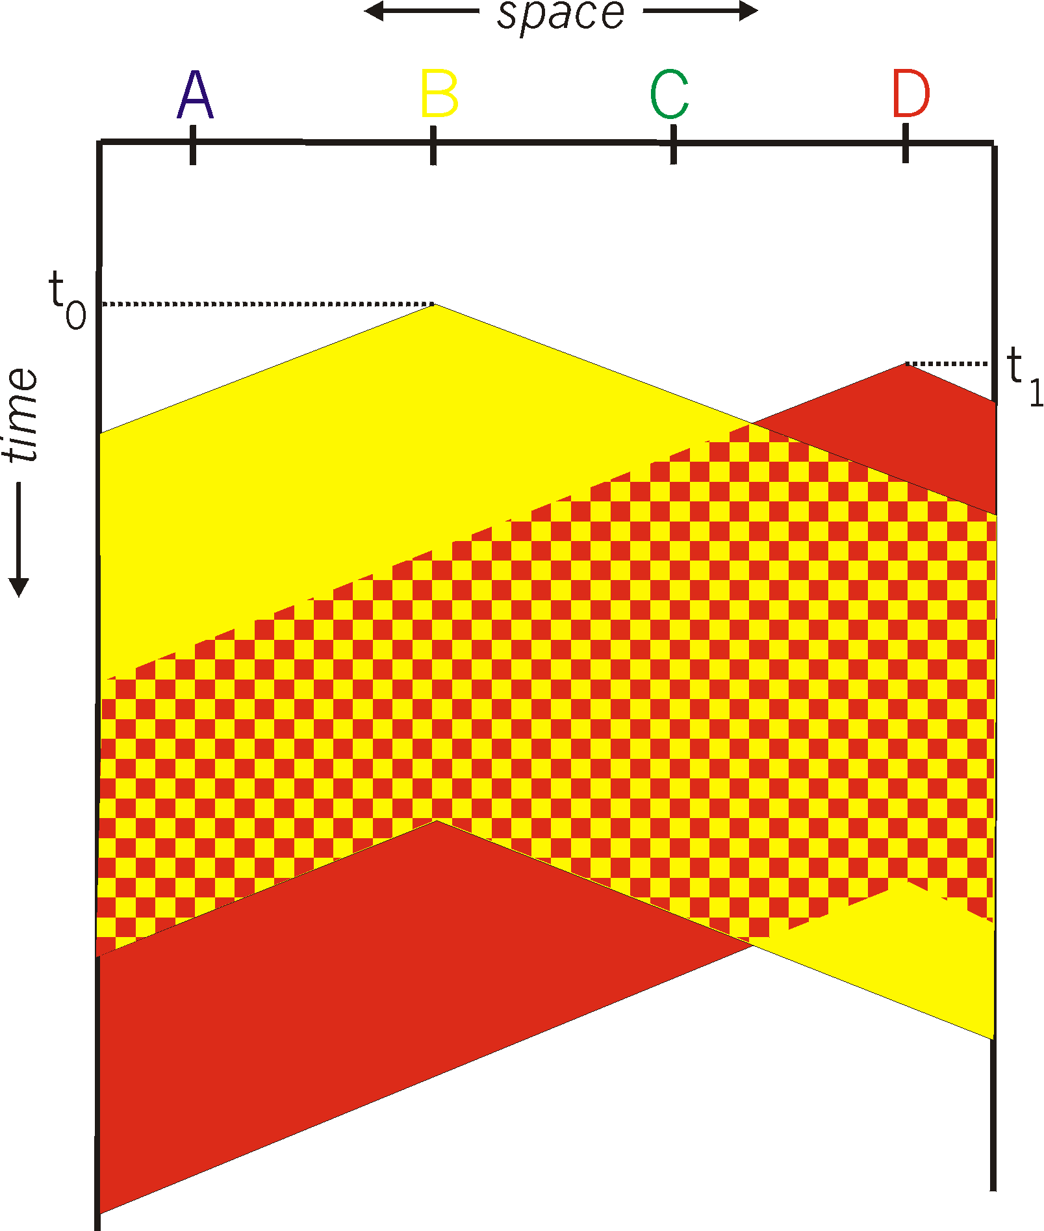
CSMA: collisions
spatial layout of nodes
collisions can still occur with carrier sensing:
propagation delay means two nodes may not hear each other’s just-started transmission
collision: entire packet transmission time wasted
distance & propagation delay play role in in determining collision probability

Slide 34
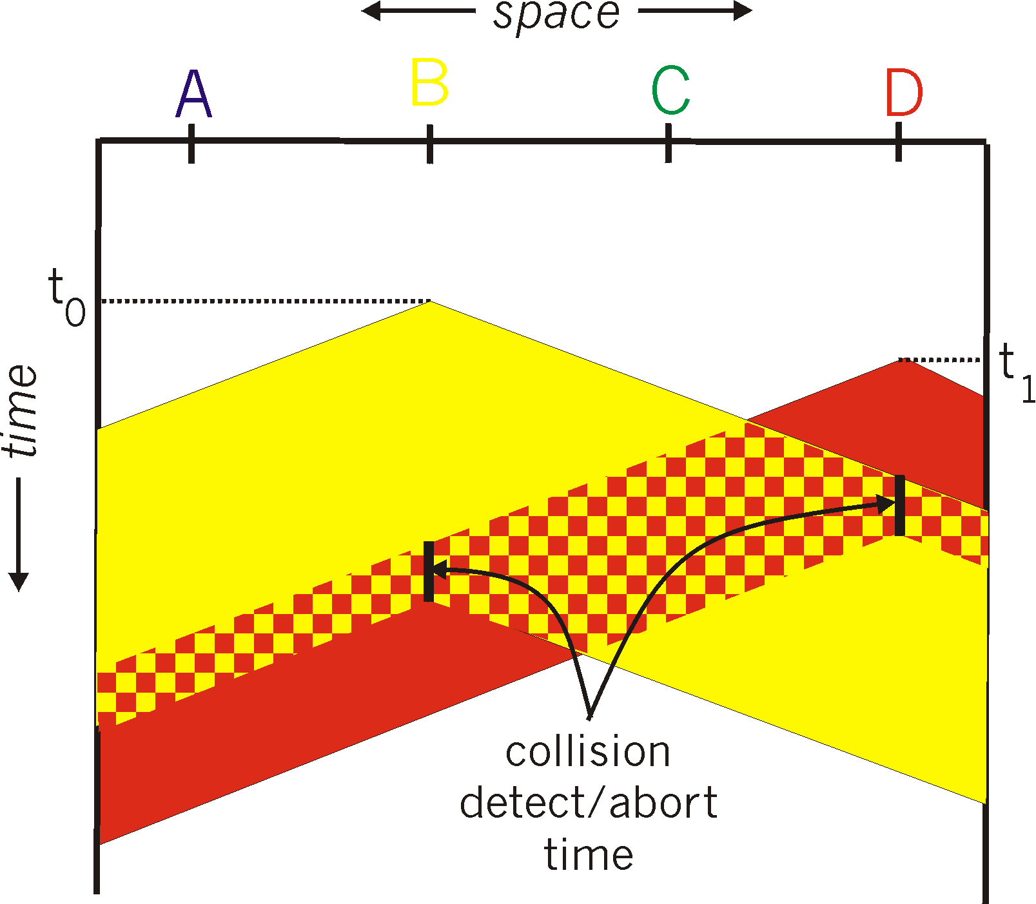
CSMA/CD:
spatial layout of nodes
CSMA/CS reduces the amount of time wasted in collisions
transmission aborted on collision detection

Slide 35
CSMA/CD efficiency
T_{prop} = max prop delay between 2 nodes in LAN
t_{trans} = time to transmit max-size frame
efficiency goes to 1
as t_{prop} goes to 0
as t_{trans} goes to infinity
better performance than ALOHA: and simple, cheap, decentralized!

Slide 36
“Taking turns” MAC protocols
channel partitioning MAC protocols:
share channel efficiently and fairly at high load
inefficient at low load: delay in channel access, 1/N bandwidth allocated even if only 1 active node!
random access MAC protocols
efficient at low load: single node can fully utilize channel
high load: collision overhead
“taking turns” protocols
look for best of both worlds!

Slide 37
“Taking turns” MAC protocols
polling:
controller node “invites” other nodes (clients)to transmit in turn
typically used with “dumb” devices
concerns:
polling overhead
latency
single point of failure (controller)
data
poll
controller
data
clients

Slide 38
“Taking turns” MAC protocols
T
token passing:
control token passed from one node to next sequentially.
token message
concerns:
token overhead
latency
single point of failure (token)
(nothing
to send)
T
data

